Slide 1
Warm Up
What is a glass ceiling?
What is minimum wage?
What’s a giveback?
What is an injunction?
What is the difference between GDP and GNP?
What were the results of the New York Presidential Primaries? What does this mean for the General election in November?

Slide 2
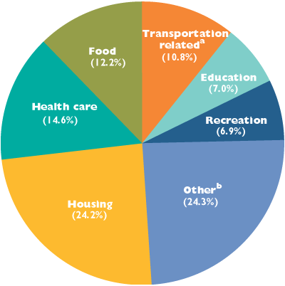
Chapter 13

Slide 3

Chapter 13
GDP – Gross Domestic Product – The dollar amount of all final goods and services produced within a country’s national borders in a year
National Income Accounting – A system of statistics and accounts that keeps track of production, consumption, saving, and investment
Excluded From GDP calculation
  Intermediate Products
  Secondhand Sales
  Nonmarket Transactions
  Underground Economy

Slide 4

Chapter 13
Intermediate Products – Products used to make other products already counted in GDP
  Tires on a new car, salt, sugar and flour, etc
Secondhand Sales – Sale of used goods
  Used car, used house, etc
Nonmarket Transactions – Transactions that do not take place in the market (services)
  Mowing your lawn, Home maintenance, etc

Slide 5

Chapter 13
Underground Economy – Unreported legal or illegal activities
  Gambling, smuggling, drugs, prostitution, etc
Limitations to GDP
  Tells nothing about the composition of output
    Nerve Gas vs. Schools
  Tells nothing about the quality of life

Slide 6
Chapter 13
GNP – Gross National Product – The dollar value of all final goods, services, and structures produced in one calendar year
GDP vs. GNP – GDP measures us as a nation, GNP measures all American’s wealth even outside of the U.S.

Slide 7

Chapter 13
NIPA – National Income and Product Accounts
  Five Income measures of a nation
    GNP – Gross National Product
    NNP – Net National Product
    NI – National Income
    PI – Personal Income
    DI – Disposable Personal Income

Slide 8
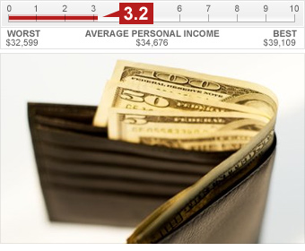
Chapter 13
NNP – Net National Product – GNP without Depreciation
NI - National Income – Income after all taxes taken out
PI – Personal Income – Income before taxes
DI – Disposable Personal Income – Income that consumers have after Personal Income tax is removed

Slide 9

Chapter 13
4 Sector of the Economy
  (C) Consumer Sector – The largest sector of Macroeconomics which includes households, individual and families
  (I) Investment Sector – Proprietorships, partnerships and corporations
  (G) Government Sector – Local, state and federal govt.
  (X-M) Foreign Sector – Consumers and Producers outside U.S.

Slide 10
Warm Up
What are the (4) prevailing economic theories?
What are the (4) sectors of the economy?
What is the equation for GDP?
What does each letter of the GDP equation stand for?
What part of the GDP equation does each economic theory advocate for stimulating?

Slide 11
Chapter 13
Output Expenditure Model – A Macroeconomic model used to show GDP
  GDP = C + I + G + (X-M)
Net Export of Goods – U.S. Exports – U.S. Imports
Inflation – Rise in general price level
  Value of money becomes less
Price Index – Stat to figure out the changes in price over time
Base Year – A year that serves a basis for all other years

Slide 12

Chapter 13
Market Basket – A representative selection of commonly purchased goods and services
CPI – Consumer Price Index – Reports on price changes on 80,000 items in 364 categories from 85 geographical areas in the U.S.

Slide 13
Chapter 13
PPI – Producer Price Index – Measures price changes paid by producers to make their product
Implicit GDP Price Deflator – an index of average levels of prices for all goods and services in the economy

Slide 14
Chapter 13
Real vs. Current GDP
  Current GDP is the dollar amount without accounting for inflation
  Real GDP is the dollar amount with inflation factored in
  Real GDP = (GDP in current dollars/GDP Price Deflator) X 100
    Pg. 353
Census – An official count of all people in the U.S.
  Urban Population – People living in incorporated villages or towns with 2,500 or more people
  Rural Population – Remainder of the population

Slide 15
Chapter 13
Historical Growth has declined
  1790 – 1860 – Growth was 3 % a year
  1860 – 1900 – 2.2%
  1900 – 1940 – 1.4%
  1940 – 2009 - .9%
Census also shows a trend towards smaller households
  1790 – 1960 – 5.8 people per house
  1960 – 2000 – 3.3
  2000 – 2009 – 2.6

Slide 16
Chapter 13
Center of Population – The point where the country would balance if it could be laid flat and all people weighed the same
    1790 – Baltimore, Maryland
    2009 – Steelville, Missouri
Demographers – People who study growth, density, and other characteristics of population

Slide 17
Chapter 13
3 Factors Affecting Population Growth
  Fertility Rate – The number of births per woman
  Life Expectancy – The average remaining life span of people
  Net Immigration – The net change in population caused by people moving in and out of the country
Baby Boom – The high birth rate years from 1946 – 1964
Dependency Ratio – Ratio based on the number of children and elderly for every 100 persons in the 18-64 bracket

Slide 18
Chapter 13
Zombie Stock – Stocks that are still being sold despite the fact that the company no longer exists
  AIG
Real GDP per capita – The dollar amount of real GDP produced on a per person basis
  Per capita has been passed by real
4 Factors influencing economic growth
  Land, Capital, Labor, Entrepreneurs

Slide 19
All Content Created by DJ Cook

